Slide 1
ZSSR ZERO SHOT SUPER RESOLUTION for microscopic images
Microscopic images enhancement using deep learning algorithm Team members: Dor Elkabetz, Lior Baruchovitch, Tzlil Polyak
Mentor: Assaf Zaritsky

Slide 2
TABLE OF CONTENTS
01
02
03
PROBLEM & SOLUTION
OUR PROCESS
TARGET
Tradeoffs between several factors,
using deep learning algorithms
Using ZSSR as enhancement for microscope images
Prove the results

Slide 3
PROBLEM & SOLUTION
01

Slide 4
Introduction
Number of labs growing over time
Microscopic images usage has been increased

Slide 5
Tradeoffs in microscopic images
Sample health
Tradeoffs between several factors
Hurtful for research quality
Spatial resolution
Temporal resolution
Signal-to-noise ratio

Slide 6


Slide 7
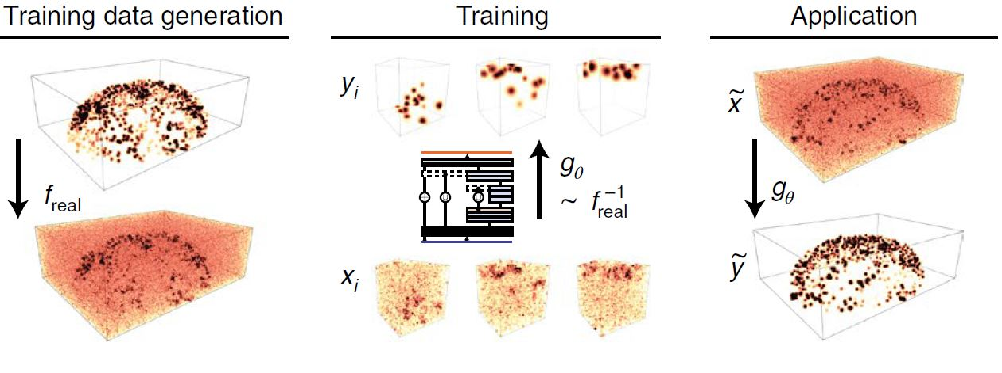
Solutions
Using Deep Learning – CARE Algorithm

Slide 8
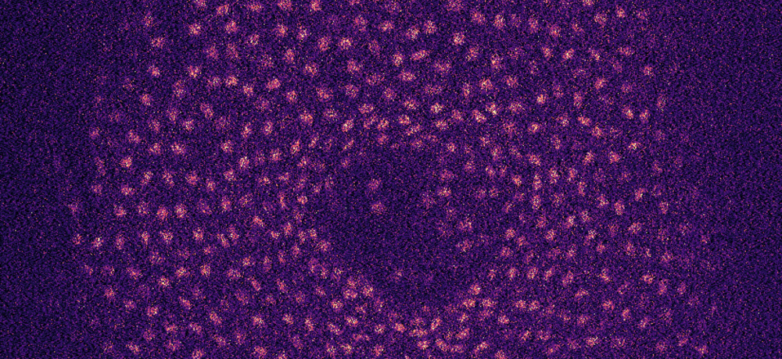
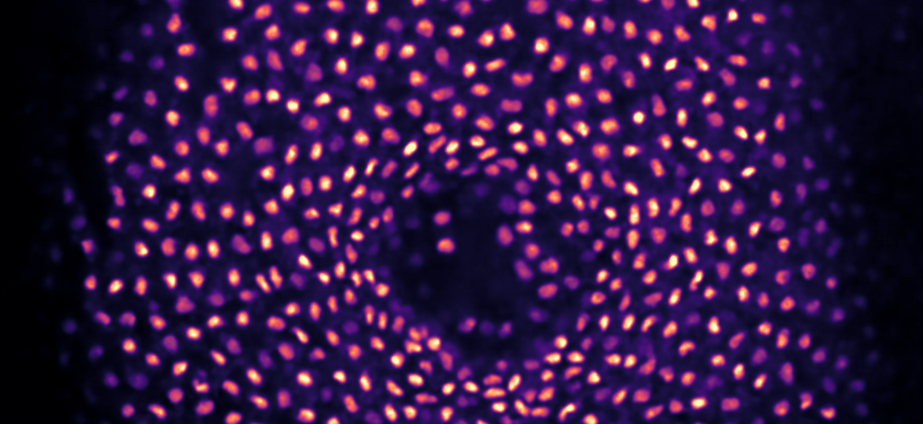
Input
Output

Slide 9
02
OUR PROCESS

Slide 10
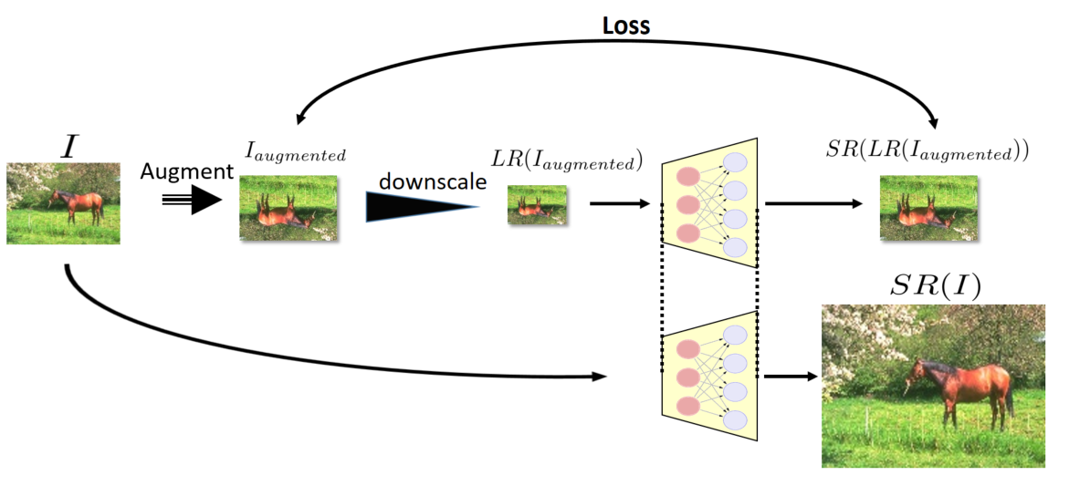
ZSSR
A deep learning image super resolution method developed by Professor Michal Irani of the Weizmann Institute.
Partitioning the original image to augmented tiles
Training of the model on the created training set
Upscaling the original image using the trained model
Downscaling all of the tiles and the creation of a HR - LR pairs for the model training set

Slide 11

OUR PROCESS
How did we fit ZSSR for microscopic images?
We use the estimated kernel in the downscaling phase of the algorithm
Kernel

Slide 12
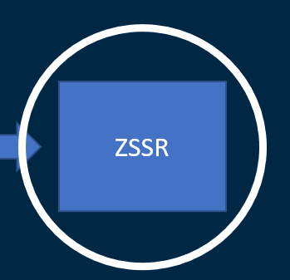
OUR PROCESS
Ground Truth
CARE
Downgraded
ZSSR
Downgraded image

Slide 13
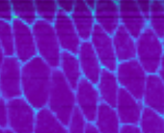
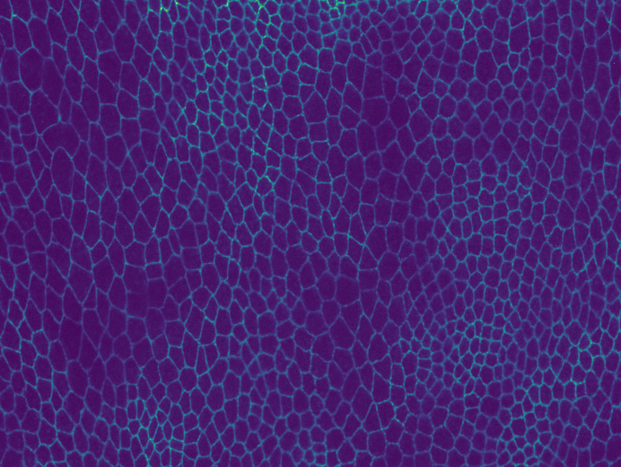
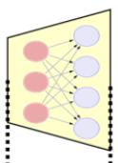
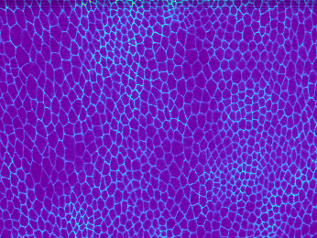
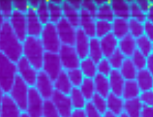
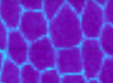
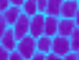
ZSSR trains a model based on the generated training set
OUR PROCESS
ZSSR generates a training set out of the downgraded image
Training set
HR
LR
Ground Truth
Downgraded
Kernel
Model
Kernel
Kernel
Downgrading using “CARE” simulator
Estimated Kernel
Kernel

Slide 14

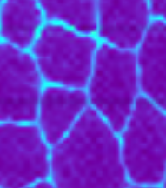
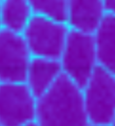
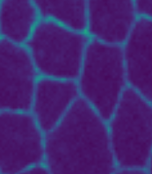
Prediction
Downgraded
Ground Truth
ZSSR upscales the downgraded image using the trained model

Slide 15
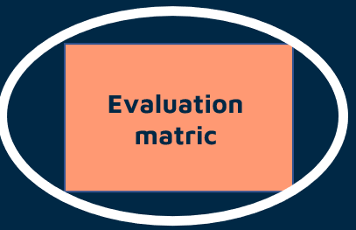
OUR PROCESS
Ground Truth
CARE
Upgraded image
Downgraded image
Evaluation matric
Downgraded
ZSSR
Downgraded image

Slide 16
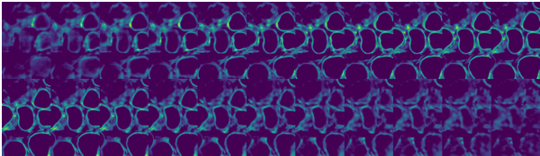
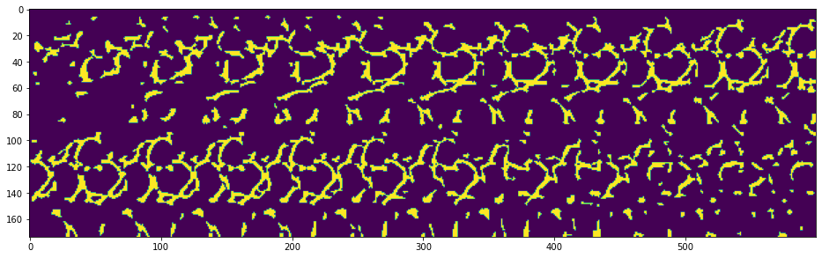
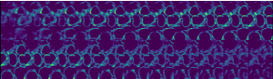
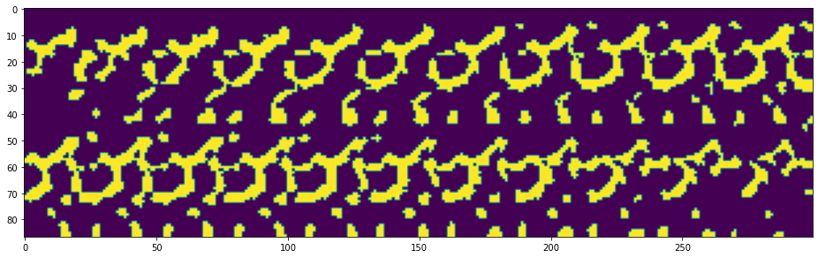
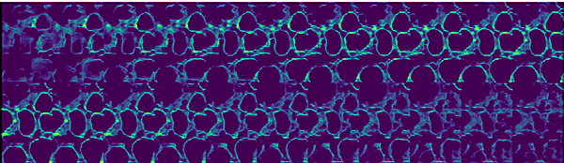
Ground Truth
Segmentation
Compare
Downgraded
Segmentation
Prediction
Segmentation

Slide 17
TARGET
03

Slide 18
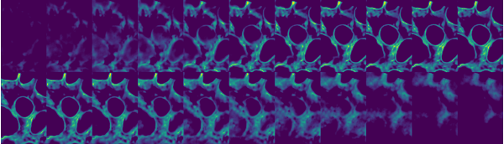
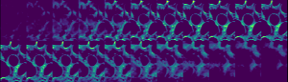
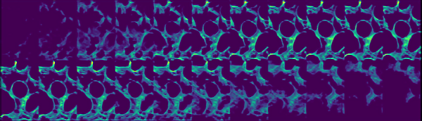


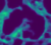
RESULTS
Ground Truth
Downgraded
Prediction

Slide 19
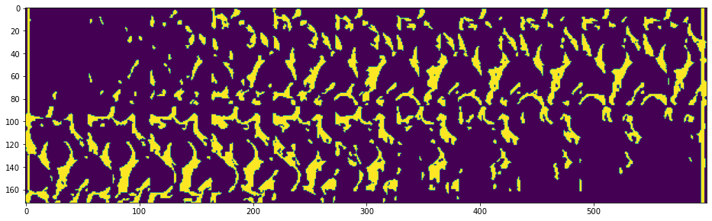
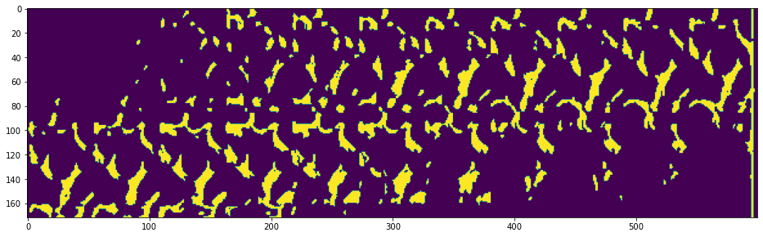
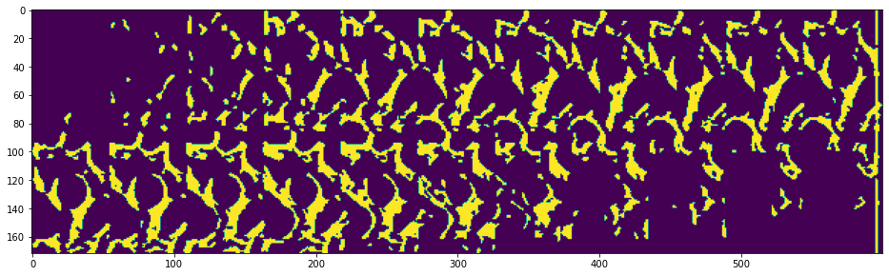
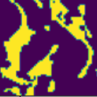
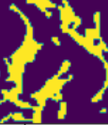
RESULTS
Ground Truth
Downgraded
Prediction
DICE= 0.789
DICE= 0.833

Slide 20
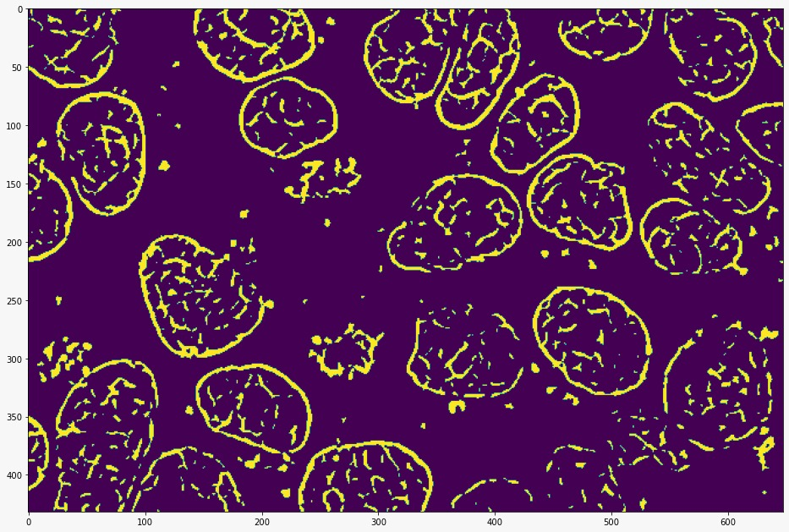
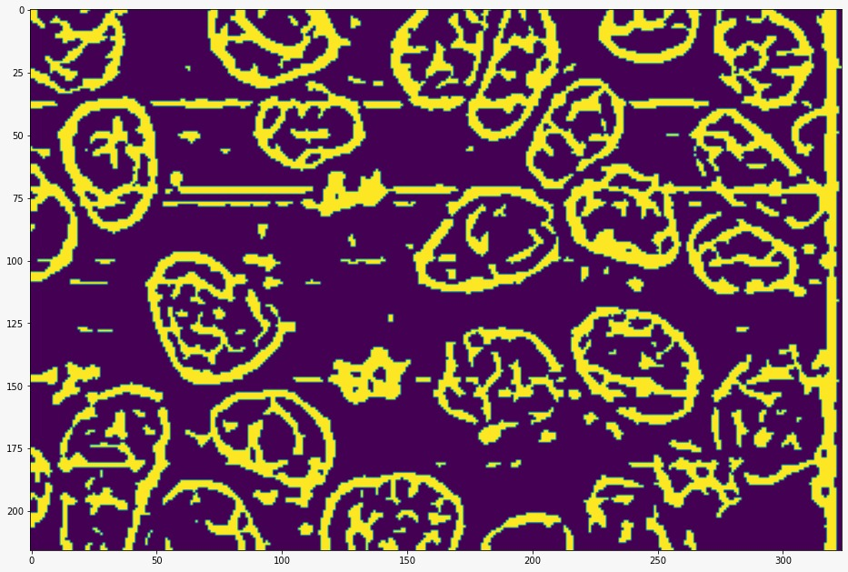
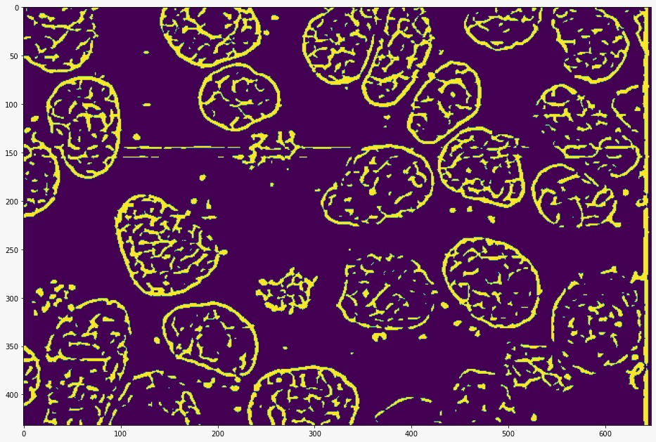
Ground Truth
Downgraded
ZSSR Prediction

Slide 21
Comparison to CARE algorithm
We used a statistical test ‘Wilcoxon’ to prove that ZSSR and CARE are not equally distributed

Slide 22
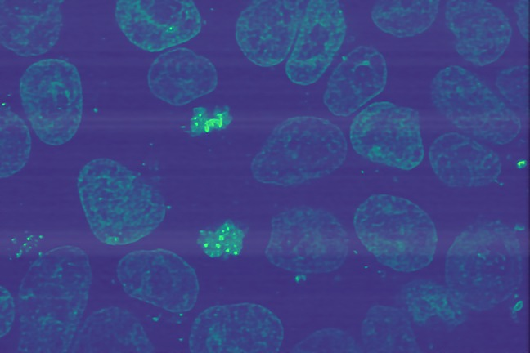
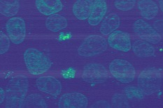
ZSSR
CARE
?
=

Slide 23
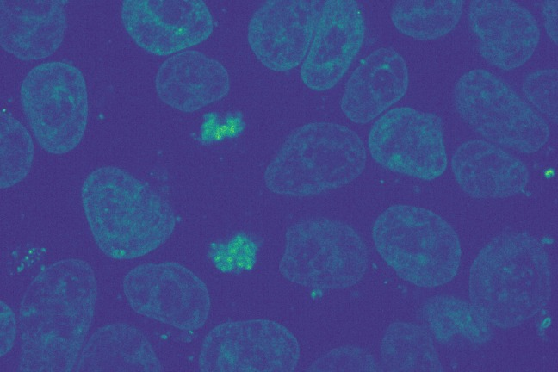
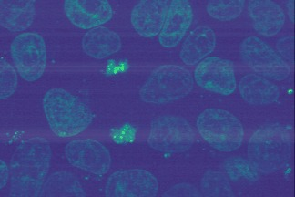
Ground Truth
Downgraded
ZSSR Prediction
TEST 1

Slide 24
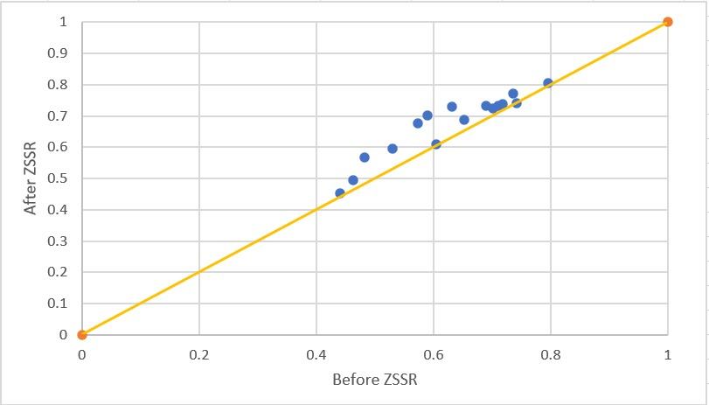
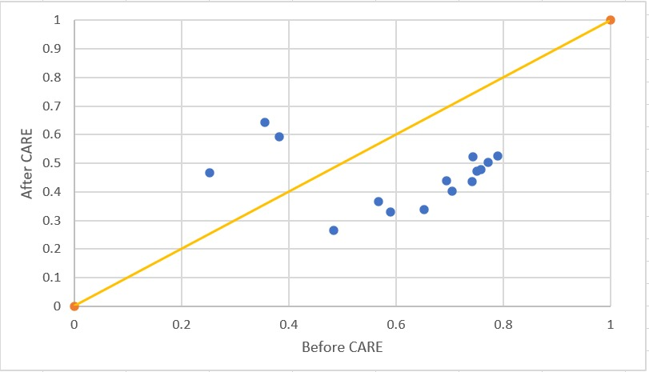
Evaluation
ZSSR
TEST1
CARE
Notes:
RESULT : 6
Reject H0 => Reject the 0 hypothesis that the results of CARE and ZSSR are equally distributed

Slide 25
Ground Truth
Downgraded
ZSSR Prediction
TEST 2

Slide 26
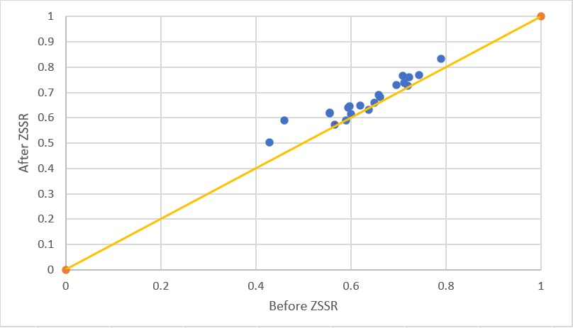
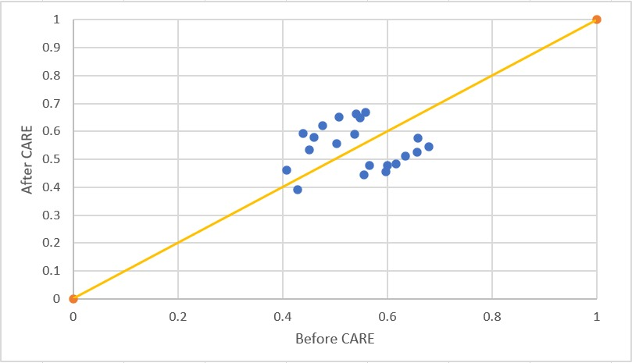
Evaluation
TEST2
ZSSR
CARE
Notes:
RESULT : 70
Reject H0 => Reject the 0 hypothesis that the results of CARE and ZSSR are equally distributed

Slide 27
SUMMARY
Accomplishments
We have reached results that better than SOTA algorithms
We use only one picture for training process
Future works
Assign the research on 3D images
Develop plugin for FIJI flatform

Slide 28
Questions?

